Slide 1
Euler Angle

Slide 2
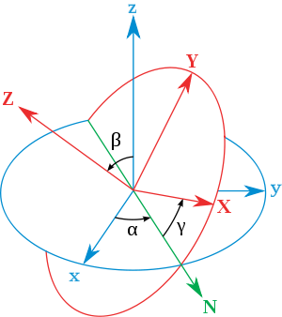
Euler Angle
Euler angles are a means of representing the spatial orientation of coordinate system as a composition of three elemental rotations starting from a known standard orientation
α is the angle between the x axis and the N axis.
β is the angle between the z axis and the Z axis.
γ is the angle between the N axis and the X axis.

Slide 3
Precession Angle
Rotate around
O
O

Slide 4
Nutation Angle
Rotate around
O
O

Slide 5
Spin Angle
Rotate around
O
O

Slide 6
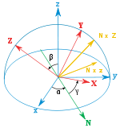
Rotation Sequence
Any target orientation can be reached, starting from a known reference orientation, using a specific sequence of intrinsic rotations, whose magnitudes are the Euler Angles of the target orientation. This example uses the z-x′-z″ sequence

Slide 7
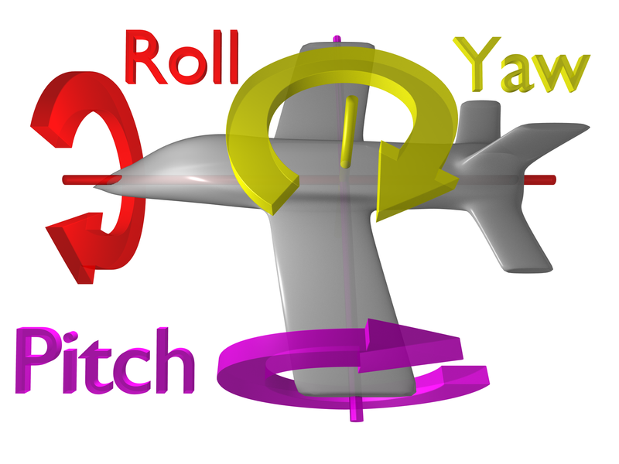
Tait–Bryan Angle
Tait–Bryan angles represent rotations about three distinct axes (e.g. x-y-z, or x-y’-z″), They are also called heading, elevation and bank, or yaw, pitch and roll.
yaw
pitch
roll

Slide 8
Gimbal Lock
Gimbal lock is the loss of one degree of freedom in a three-dimensional.
Gimbal locked airplane. When the pitch (green) and yaw (magenta) gimbals become aligned, changes to roll (blue) and yaw apply the same rotation to the airplane.
演示视频：
http://www.tudou.com/programs/view/C39rWfrXRkY

Slide 9
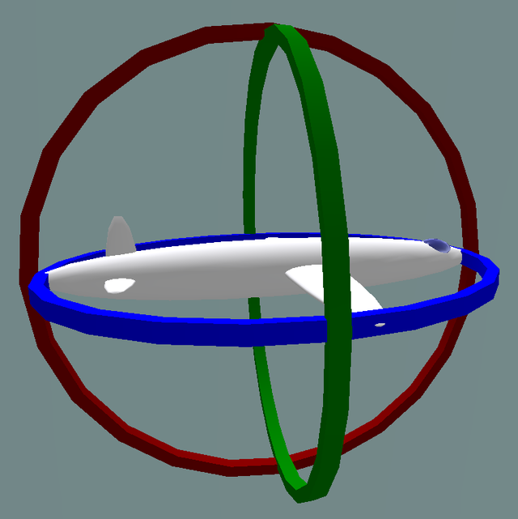
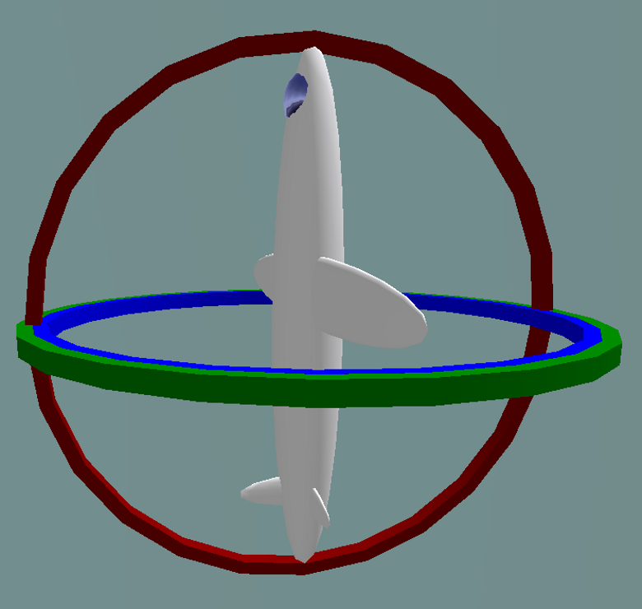
Gimbal Lock
If the aircraft pitches up 90 degrees, the aircraft and platform's Yaw axis gimbal becomes parallel to the Roll axis gimbal, and changes about yaw can no longer be compensated for.
Normal situation: the three gimbals are independent
Gimbal lock: two out of the three gimbals are in the same plane, one degree of freedom is lost

Slide 10
Task2
使用加速度的数据得到飞行器的姿态
当堂验收

